Slide 1
Predicting growth conditions from omics data via machine learning & Measuring effects of genes on decision boundaries
Umut Caglar UT Austin (Wilke Lab)

Slide 2
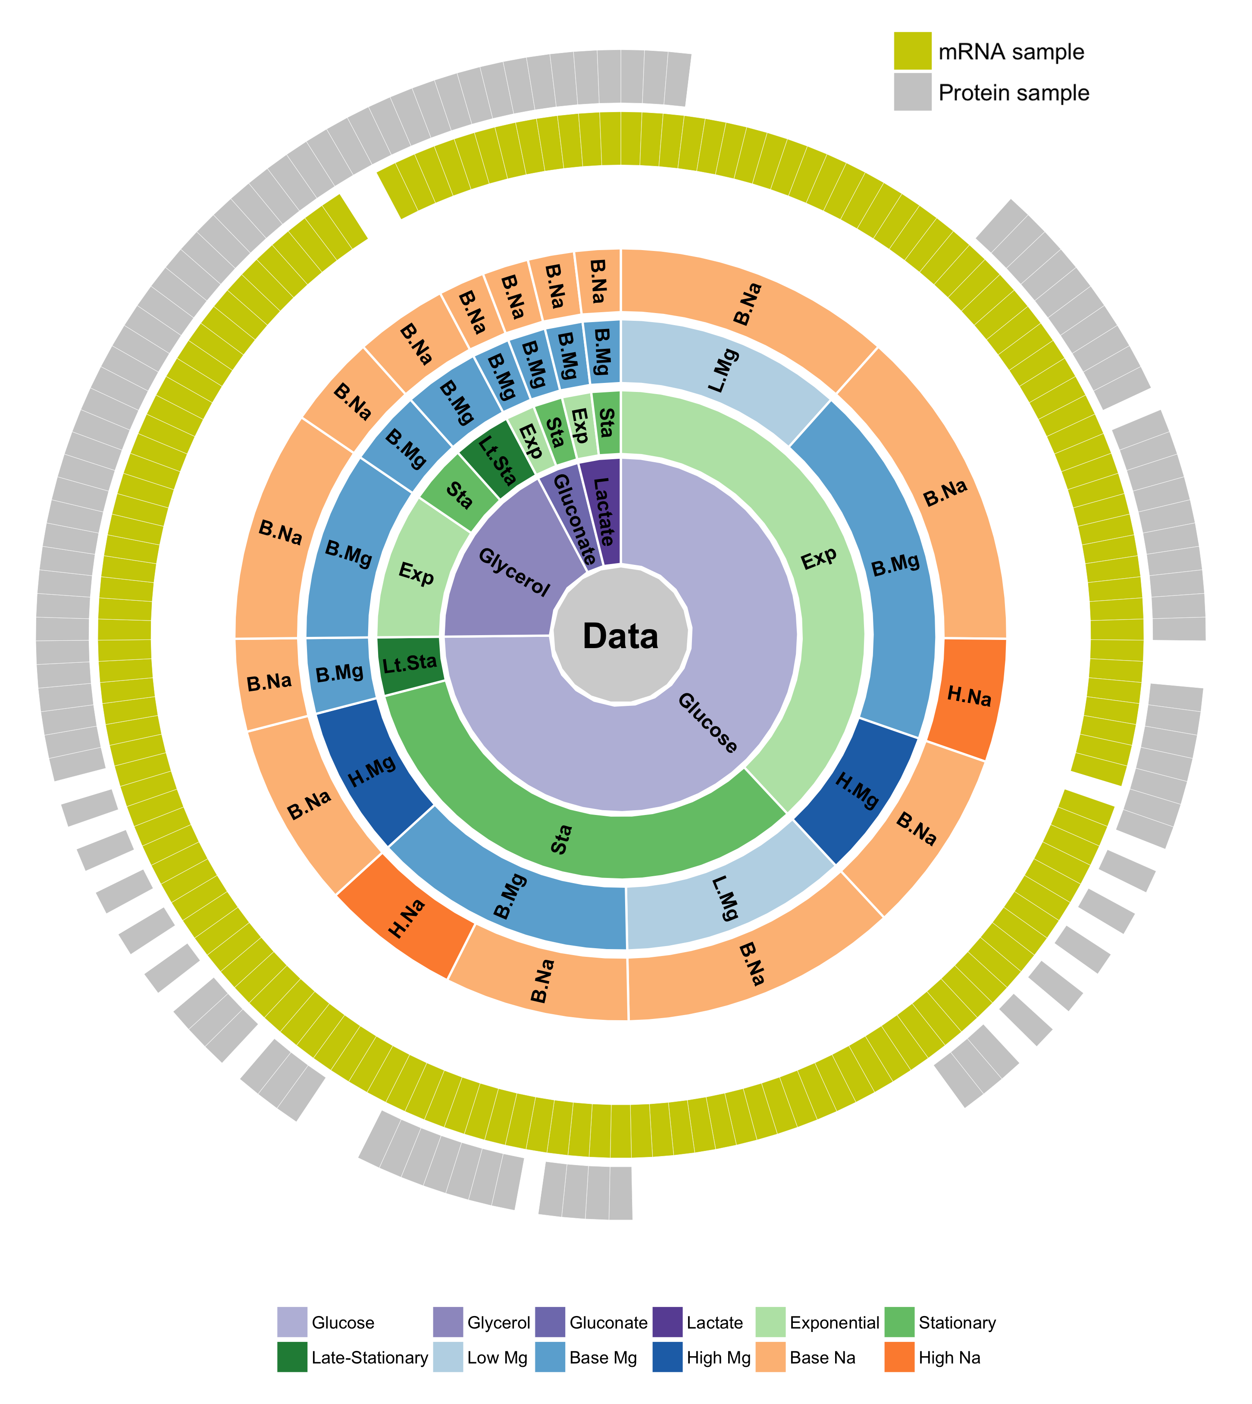
We have a large data set to learn bacterial response to external conditions

Slide 3
Q: Can we predict external conditions of bacteria growth by using machine learning technics?

Slide 4
Overall analysis approach
Samples
Dimension Reduction
Machine Learning
Prediction
Notes:
Flowchart: samples -> dimension reduction -> machine learning -> prediction
Text will be black
E-coli

Slide 5
PCA on data
Conditions: PCA axis 1&2, glucose, base Mg, base Na, exponential & stationary
Notes:
MgSO4 -> Magnesium sulfate
NaCl -> Sodium chloride

Slide 6
Machine learning: SVM with radial kernel
Conditions: PCA axis 1&2, glucose, base Mg, base Na, exponential & stationary model = "SVM", kernel = "radial", type ="C", cost=20, gamma=1/2

Slide 7
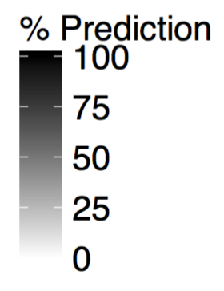
Example result
Predicted Value
A
B
C
A
True Value
B
C

Slide 8
Machine learning pipeline
INITIAL DATA PREPERATION
Find out subsets of data
Sum technical replicates
DeSeq2 -> Size factor normalization (With “+1” addition)
Log transformation (vst)
Labels
SAMPLES

Slide 9
Machine learning pipeline
INITIAL DATA PREPERATION
Find out subsets of data
Sum technical replicates
DeSeq2 -> Size factor normalization (With “+1” addition)
Log transformation (vst)
Semi-random data division
(Protect sub sample ratios)
Training set 80%
Test set 20%
Labels
Labels
SAMPLES

Slide 10
Machine learning pipeline
INITIAL DATA PREPERATION
Find out subsets of data
Sum technical replicates
DeSeq2 -> Size factor normalization (With “+1” addition)
Log transformation (vst)
Semi-random data division
(Protect sub sample ratios)
Training set 80%
Test set 20%
Labels
Batch correction object
SAMPLES
Batch Correction (fSVA)
Labels
PCA Scale = TRUE
Center = TRUE
PCA rotation object
Dim. Reduced Training 80%
Labels

Slide 11
Machine learning pipeline
INITIAL DATA PREPERATION
Find out subsets of data
Sum technical replicates
DeSeq2 -> Size factor normalization (With “+1” addition)
Log transformation (vst)
Semi-random data division
(Protect sub sample ratios)
Training set 80%
Test set 20%
Labels
Batch correction object
SAMPLES
Batch Correction (fSVA)
Labels
PCA Scale = TRUE
Center = TRUE
PCA rotation object
Dim. Reduced Training 80%
Dim. Reduced Test
20%
Labels

Slide 12
Machine learning pipeline
INITIAL DATA PREPERATION
Find out subsets of data
Sum technical replicates
DeSeq2 -> Size factor normalization (With “+1” addition)
Log transformation (vst)
Semi-random data division
(Protect sub sample ratios)
Training set 80%
Test set 20%
Labels
Batch correction object
SAMPLES
Batch Correction (fSVA)
Labels
PCA
Scale = TRUE
Center = TRUE
PCA rotation object
Dim. Reduced Training 80%
Dim. Reduced Test
20%
Labels
Train SVM
C-Classification (c = 1)
Radial Kernel (Gamma = 1/d)
Class weight normalization

Slide 13
Machine learning pipeline
INITIAL DATA PREPERATION
Find out subsets of data
Sum technical replicates
DeSeq2 -> Size factor normalization (With “+1” addition)
Log transformation (vst)
Semi-random data division
(Protect sub sample ratios)
Training set 80%
Test set 20%
Labels
Batch correction object
SAMPLES
Batch Correction (fSVA)
Labels
PCA
Scale = TRUE
Center = TRUE
PCA rotation object
Dim. Reduced Training 80%
Dim. Reduced Test
20%
Labels
Train SVM
C-Classification (c = 1)
Radial Kernel (Gamma = 1/d)
Class weight normalization
Model

Slide 14
Machine learning pipeline
INITIAL DATA PREPERATION
Find out subsets of data
Sum technical replicates
DeSeq2 -> Size factor normalization (With “+1” addition)
Log transformation (vst)
Semi-random data division
(Protect sub sample ratios)
Training set 80%
Test set 20%
Labels
Batch correction object
SAMPLES
Batch Correction (fSVA)
Labels
PCA
Scale = TRUE
Center = TRUE
PCA rotation object
Dim. Reduced Training 80%
Dim. Reduced Test
20%
Labels
Train SVM
C-Classification (c = 1)
Radial Kernel (Gamma = 1/d)
Class weight normalization
Model
Prediction

Slide 15
Machine learning pipeline
Do it 1000 times
INITIAL DATA PREPERATION
Find out subsets of data
Sum technical replicates
DeSeq2 -> Size factor normalization (With “+1” addition)
Log transformation (vst)
Semi-random data division
(Protect sub sample ratios)
Training set 80%
Test set 20%
Labels
Batch correction object
SAMPLES
Batch Correction (fSVA)
Labels
PCA
Scale = TRUE
Center = TRUE
PCA rotation object
Dim. Reduced Training 80%
Dim. Reduced Test
20%
Labels
Train SVM
C-Classification (c = 1)
Radial Kernel (Gamma = 1/d)
Class weight normalization
Model
Prediction

Slide 16
mRNA results

Slide 17
We can distinguish growth phase from mRNA data

Slide 18
We can distinguish carbon sources from mRNA data moderately. Most significant signal is associated with glucose

Slide 19
We can distinguish Mg concentrations from mRNA data. Least significant signal is associated with high Mg

Slide 20
We can NOT distinguish Na concentrations from mRNA data

Slide 21
mRNA summary

Slide 22
We can distinguish growth phase, carbon sources and Mg concentrations but not for Na concentrations from mRNA data

Slide 23
Protein data

Slide 24
We can distinguish growth phase moderately from protein data. Most significant signal is associated with exponential phase

Slide 25
We can distinguish carbon sources from protein data.

Slide 26
We can NOT distinguish Mg concentrations from protein data. Most dominant signal is associated with base Mg

Slide 27
We can NOT distinguish Na concentrations from protein data.

Slide 28
Protein summary

Slide 29
We can distinguish carbon sources and growth phase but NOT for Mg and Na concentrations from protein data

Slide 30
Exponential vs Stationary Phases

Slide 31
For mRNA data carbon sources become indistinguishable as time pass. Protein data also shows a similar but weaker trend
All Phase
Exponential
Stationary

Slide 32
For mRNA data carbon sources become indistinguishable as time pass. Protein data also shows a similar but weaker trend
All Phase
Exponential
Stationary

Slide 33
For mRNA and protein data Mg concentrations become less distinguishable as time pass.
All Phase
Exponential
Stationary

Slide 34
For mRNA and protein data Mg concentrations become less distinguishable as time pass.
All Phase
Exponential
Stationary

Slide 35
For mRNA data Na become less distinguishable as time pass. For proteins Na is not distinguishable.
All Phase
Exponential
Stationary

Slide 36
For mRNA data Na become less distinguishable as time pass. For proteins Na is not distinguishable.
All Phase
Exponential
Stationary

Slide 37
Overall trend states that as time pass predictability decreases

Slide 38
More complex examples

Slide 39
For mRNA data, prediction works quite well

Slide 40
For protein data, prediction quality is slightly worse

Slide 41
Combining data

Slide 42
Proteins are strong in carbon sources Diagonal sum: 842

Slide 43
mRNA is bad in stationary phase Diagonal sum: 749

Slide 44
Combined data (mRNA + protein) have no synergistic effects Diagonal sum: 888

Slide 45
Gene relations

Slide 46
PCA on data
Conditions: PCA axis 1&2, glucose, base Mg, base Na, exponential & stationary
Notes:
MgSO4 -> Magnesium sulfate
NaCl -> Sodium chloride

Slide 47
Machine learning: SVM with radial kernel
Conditions: PCA axis 1&2, glucose, base Mg, base Na, exponential & stationary model = "SVM", kernel = "radial", type ="C", cost=20, gamma=1/2

Slide 48
Machine learning: SVM multi Cluster
Conditions: PCA axis 1&2, glucose, base Mg, base Na, exponential & stationary model = "SVM", kernel = "radial", type ="C", cost=20, gamma=1/2

Slide 49
Machine learning: SVM multi Cluster
MURI 113 Ex - Sta -> Sta
Ex - laSta -> laSta Sta - laSta -> Sta
Conditions: PCA axis 1&2, glucose, base Mg, base Na, exponential & stationary model = "SVM", kernel = "radial", type ="C", cost=20, gamma=1/2

Slide 50
Machine learning: deletion of first 100 mRNAs
Conditions: PCA axis 1&2, glucose, base Mg, base Na, exponential & stationary model = "SVM", kernel = "radial", type ="C", cost=20, gamma=1/2

Slide 51
Machine learning pipeline
INITIAL DATA PREPERATION
Find out subsets of data
Sum technical replicates
DeSeq2 -> Size factor normalization (With “+1” addition)
Log transformation (vst)
Labels
SAMPLES

Slide 52
Machine learning pipeline
INITIAL DATA PREPERATION
Find out subsets of data
Sum technical replicates
DeSeq2 -> Size factor normalization (With “+1” addition)
Log transformation (vst)
Prepared Data
Labels
SAMPLES

Slide 53
Machine learning pipeline
INITIAL DATA PREPERATION
Find out subsets of data
Sum technical replicates
DeSeq2 -> Size factor normalization (With “+1” addition)
Log transformation (vst)
Prepared Data
Batch Correction (fSVA)
Labels
SAMPLES
Batch Corrected Data

Slide 54
Machine learning pipeline
INITIAL DATA PREPERATION
Find out subsets of data
Sum technical replicates
DeSeq2 -> Size factor normalization (With “+1” addition)
Log transformation (vst)
Prepared Data
Batch Correction (fSVA)
Labels
SAMPLES
Batch Corrected Data
PCA
Scale = TRUE
Center = TRUE

Slide 55
Machine learning pipeline
INITIAL DATA PREPERATION
Find out subsets of data
Sum technical replicates
DeSeq2 -> Size factor normalization (With “+1” addition)
Log transformation (vst)
Prepared Data
Batch Correction (fSVA)
Labels
SAMPLES
Batch Corrected Data
PCA
Scale = TRUE
Center = TRUE
Train SVM
C-Classification (c = 1)
Radial Kernel (Gamma = 1/d)
Class weight normalization

Slide 56
Machine learning pipeline
INITIAL DATA PREPERATION
Find out subsets of data
Sum technical replicates
DeSeq2 -> Size factor normalization (With “+1” addition)
Log transformation (vst)
Prepared Data
Batch Correction (fSVA)
Labels
SAMPLES
Batch Corrected Data
PCA
Scale = TRUE
Center = TRUE
Train SVM
C-Classification (c = 1)
Radial Kernel (Gamma = 1/d)
Class weight normalization
Ref.
Model

Slide 57
Machine learning pipeline
INITIAL DATA PREPERATION
Find out subsets of data
Sum technical replicates
DeSeq2 -> Size factor normalization (With “+1” addition)
Log transformation (vst)
Prepared Data
Batch Correction (fSVA)
Labels
SAMPLES
Batch Corrected Data
Batch Corrected Data Missing Gene
PCA
Scale = TRUE
Center = TRUE
PCA
Scale = TRUE
Center = TRUE
Train SVM
C-Classification (c = 1)
Radial Kernel (Gamma = 1/d)
Class weight normalization
Train SVM
C-Classification (c = 1)
Radial Kernel (Gamma = 1/d)
Class weight normalization
Ref.
Model
Model

Slide 58
Machine learning pipeline
INITIAL DATA PREPERATION
Find out subsets of data
Sum technical replicates
DeSeq2 -> Size factor normalization (With “+1” addition)
Log transformation (vst)
Prepared Data
Batch Correction (fSVA)
Labels
SAMPLES
Batch Corrected Data
Batch Corrected Data Missing Gene
PCA
Scale = TRUE
Center = TRUE
PCA
Scale = TRUE
Center = TRUE
Train SVM
C-Classification (c = 1)
Radial Kernel (Gamma = 1/d)
Class weight normalization
Train SVM
C-Classification (c = 1)
Radial Kernel (Gamma = 1/d)
Class weight normalization
Ref.
Model
Compare
Model

Slide 59
Machine learning pipeline
INITIAL DATA PREPERATION
Find out subsets of data
Sum technical replicates
DeSeq2 -> Size factor normalization (With “+1” addition)
Log transformation (vst)
Prepared Data
Batch Correction (fSVA)
Labels
SAMPLES
Batch Corrected Data
Batch Corrected Data Missing Gene
PCA
Scale = TRUE
Center = TRUE
PCA
Scale = TRUE
Center = TRUE
For all genes
Train SVM
C-Classification (c = 1)
Radial Kernel (Gamma = 1/d)
Class weight normalization
Train SVM
C-Classification (c = 1)
Radial Kernel (Gamma = 1/d)
Class weight normalization
Ref.
Model
Compare
Model

Slide 60
Comparison of 16*15/2=120 10-dimensional nonlinear objects is difficult

Slide 61
Generate low-discrepancy sequences by using SOBOL NUMBERS
Generate Sample Points
&
Decision Value Matrix

Slide 62
low-discrepancy sequences SOBOL NUMBERS

Slide 63
mRNA Results: Top 10
mRNA
 | Carbon Source | Growth Phase | Mg Levels | Na Levels
1 | cusR | rimJ | nuoG | rimJ
2 | crr | yidI | emrK
3 | rimJ | mukE | murP | spy
4 | mukE | crr | malZ | rhlE
5 | araH | rhlE | ybgG | ynjF
6 | ycbW | ycbW | yqjH | yrfG
7 | rhlE | spy | rimJ | gspL
8 | alsB | yjbM | ycbW | garL
9 | yhhK | ycbV | cusR | yjbM
10 | yrfG | insB-21 | pntA | yhhK

Slide 64
Protein Results: Top 10
Proteins
 | Carbon Source | Growth Phase | Mg Levels | Na Levels
1 | greA | greA | yeiH | greA
2 | rpsU | rpsU | dxs | rpsU
3 | ppdC | ppdC | ybhL | dicB
4 | fkpA | hlpA | yqjB | rarD
5 | frr | ksgA | trkH | ynaJ
6 | fimH | ycfC | ybiA | ppdC
7 | yhjJ | yniC | greA | sucA
8 | rarD | fimH | ybfC | rimM
9 | idnK | ydgJ | yraP | accC
10 | yfiR | tktA | yceI | folE

